Slide 1

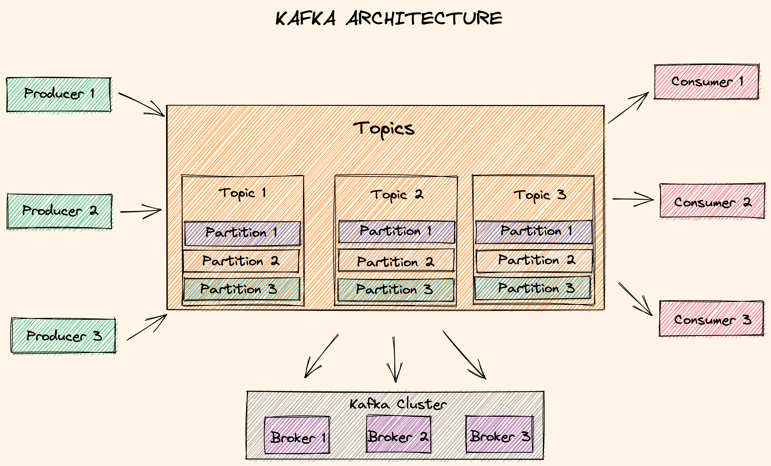
Kafka Architecture
Kafka brokers: Servers run in a cluster
Topics: Logical data unit that holds multiple partition
Partitions: Smallest storage unit that holds subset of records
Producers: Writes to end of a specific partition
Consumers: Reads from a partition using an offset
Replication: Resilient and fault-tolerant
Scaling: Partition strategy
Immutable append-only event logs

Slide 2
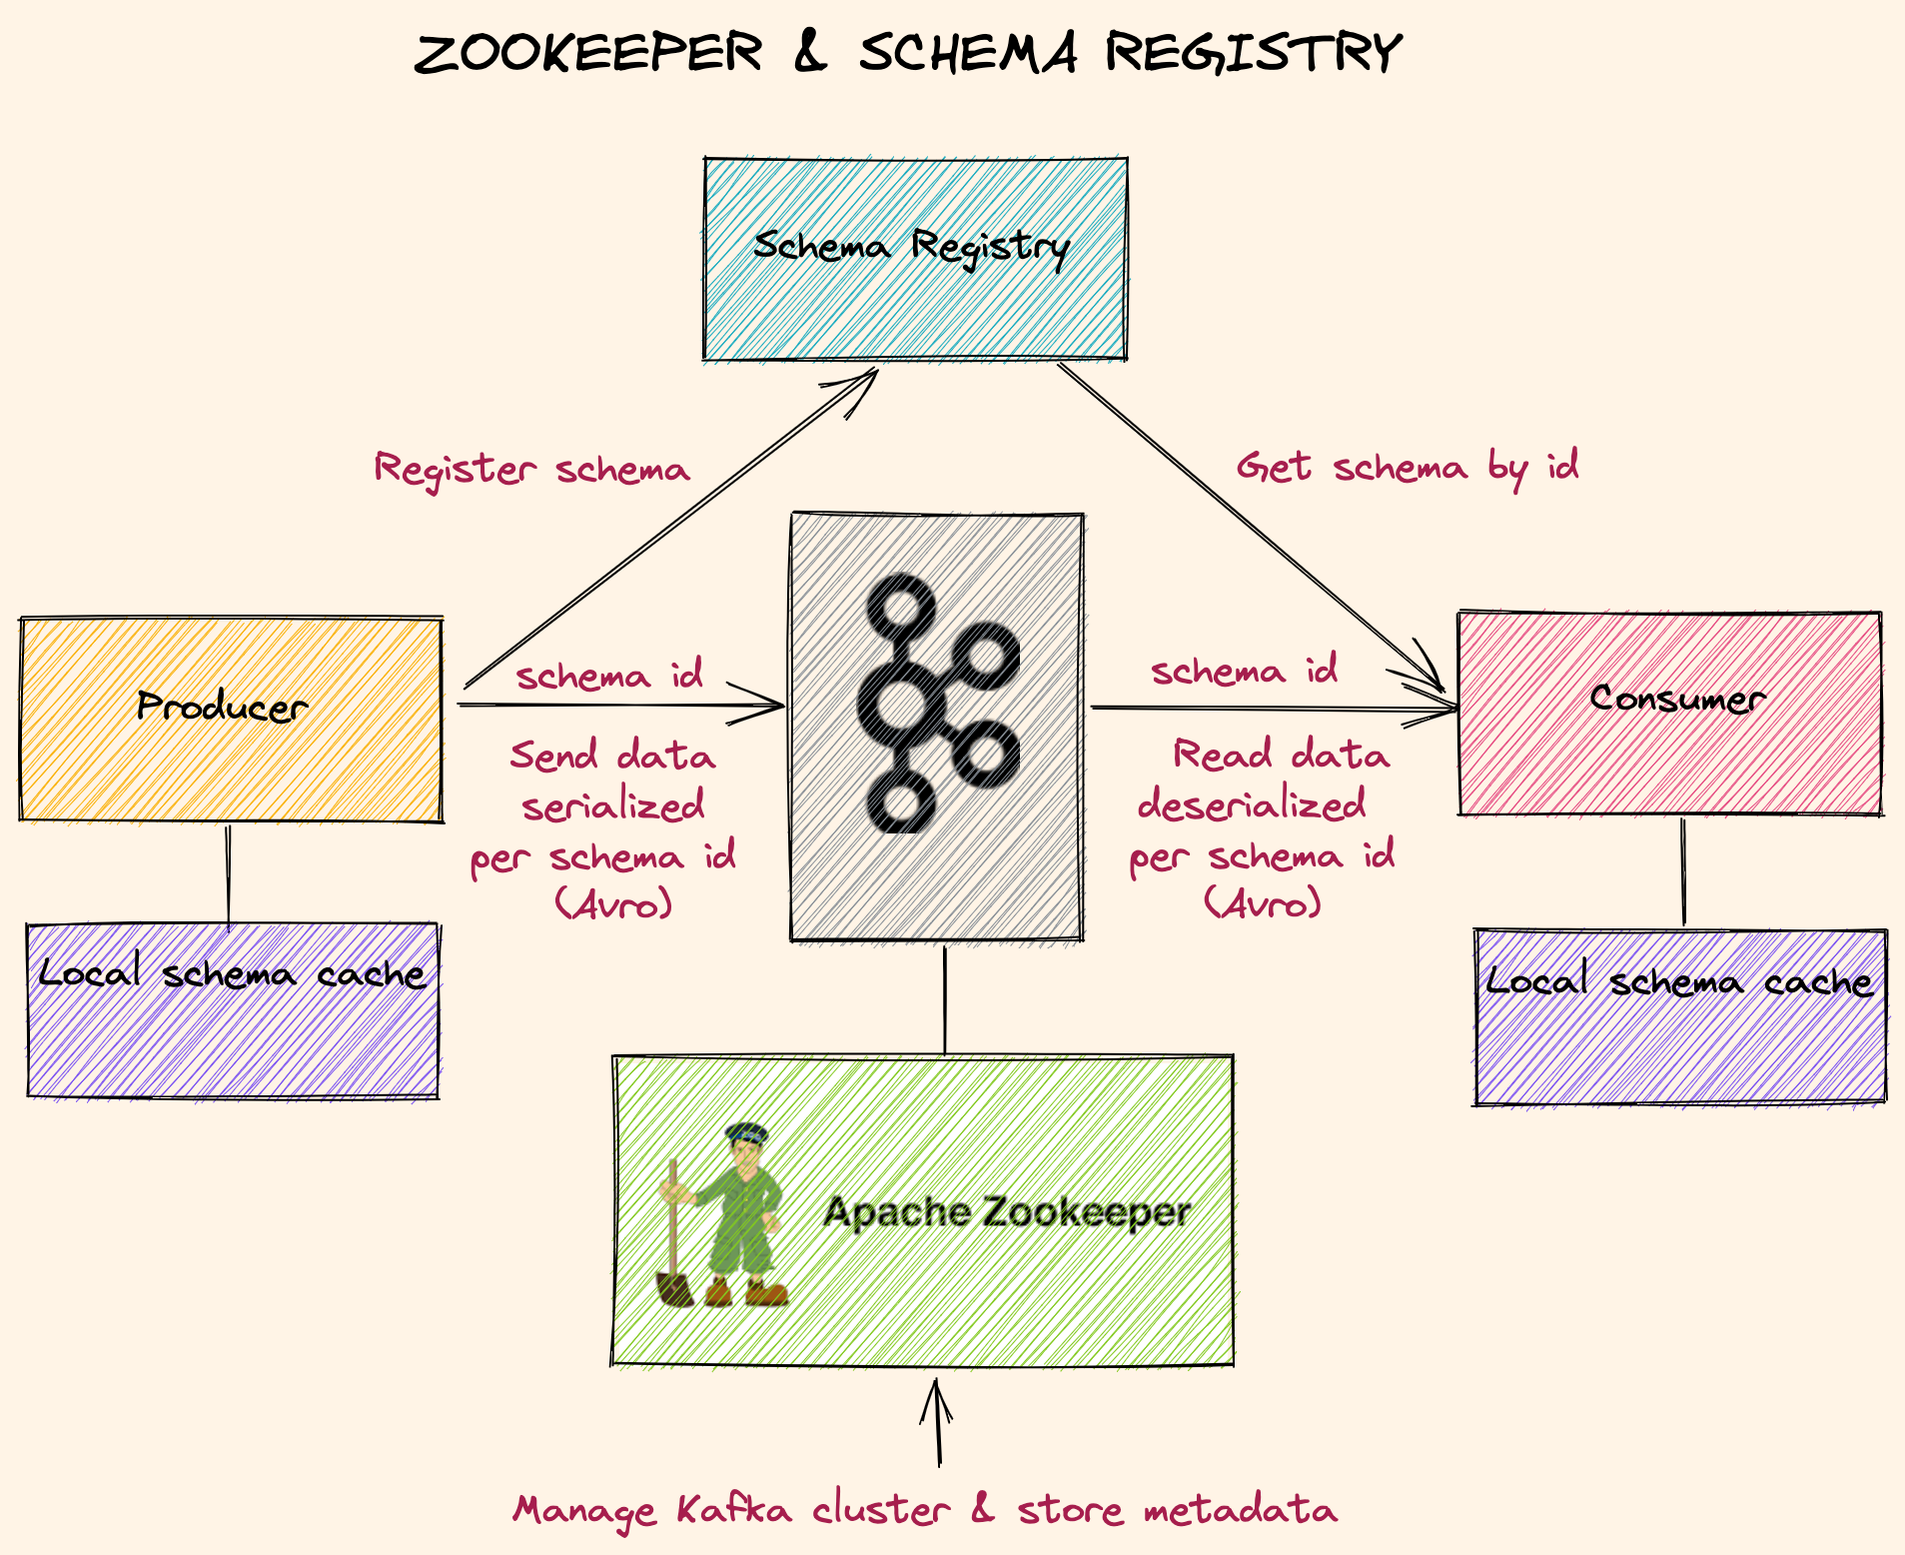
Zookeeper & Schema Registry
Zookeeper: Manage cluster, store metadata
KIP-500: Removal of zookeeper, still not production ready!
https://www.confluent.io/blog/removing-zookeeper-dependency-in-kafka/
KIP-500 Status Updates
Schema registry: Stores versioned history of all schemas by id
Producer send schema to schema registry and get schema id
Consumer retrieve schema by id
Data is serialized/deserialized with registered schema
Notes:
https://cwiki.apache.org/confluence/display/KAFKA/KIP-833%3A+Mark+KRaft+as+Production+Ready
Mark KRaft as production-ready for new clusters in the upcoming Kafka 3.3 release. https://kafka.apache.org/downloads
Deprecate ZooKeeper mode in the upcoming Kafka 3.4 release
Plan to remove ZooKeeper mode entirely in Kafka 4.0.

